Slide 1
Meet EPRA, the European Public Real Estate Association

Slide 2
EPRA’s MISSION STATEMENT
“EPRA’s mission is to promote, develop, and represent the European listed real estate sector.”

Slide 3
The Association
Research & Indexes
Investor Outreach
Reporting & Accounting – Sustainability
Public Affairs
Events & Networking

Slide 4
Research & Indexes
High quality, independent academic & forward-looking market research
Leading Global Real Estate benchmark: FTSE EPRA Nareit Index

Slide 5
Investor Outreach
We bring the market story to investors → EPRA’s informing & educating role
We bring companies to investors → EPRA corporate access events

Slide 6
Reporting & Accounting – Sustainability
Development of financial & sustainability best practices recommendations
Advocacy to international accounting bodies – IASB/ESMA/EFRAG/IFRIC

Slide 7
Public Affairs
Influence on the regulatory process at EU & national levels
Advocacy for the development of REIT regimes in Europe

Slide 8
Events & Networking
Organisation of EPRA flagship events
EPRA Annual Conference
Insight events in several locations
Ad-hoc industry workshops & seminars

Slide 9
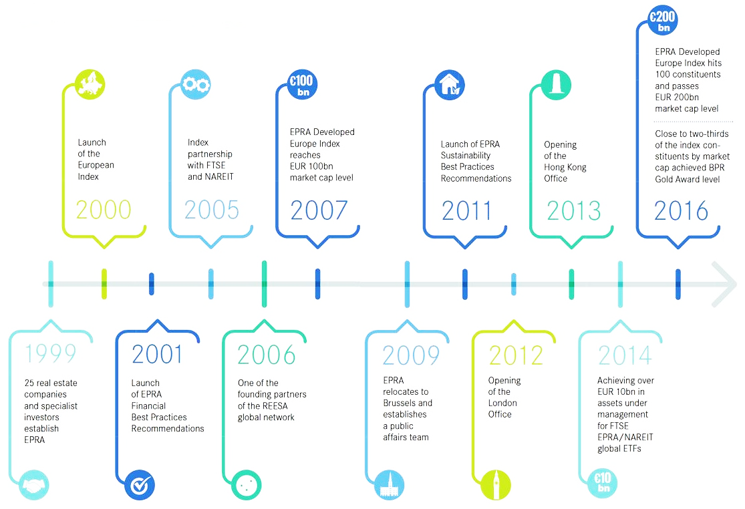
EPRA Milestones

Slide 10
EPRA Membership
Member | No. | %
Property Companies & REITS | 168 | 61
Investors* | 62 | 22
Academics | 29 | 11
Consultants & others | 18 | 6
Total | 277 | 100
Representing
> €450 Billion
of real estate assets
*Investment Companies, Insurance Companies/Funds, Banks & Stockbrokers

Slide 11
Contact
General enquiries: info@epra.com
Switchboard: +32 0 2739 1010
Find more information on www.epra.com
HEAD OFFICE
Square de Meeûs 23
1000 Brussels, BE
UK OFFICE
Devonshire House, One Mayfair Place
London W1J 8AJ, UK
HONG KONG OFFICE
Unit A, 25/F, United Centre
No. 95 Queensway, HK
The European Public Real Estate Association ("EPRA") is a not-for-profit association registered in Belgium with registered number 0811738560 and VAT registration number BE 0811.738.560. Our registered office is at Square De Meeus23, 1000 Brussels, Belgium. This presentation is intended solely for the addressee and may contain confidential information. Do not use, copy or disclose the information contained in this presentation. Users of information in this presentation do so at their own risk and must still comply with their responsibilities to their regulatory authority or shareholders.
We are not liable for incorrect use or interpretation of our published research, policies or guidance. We accept no liability for damage suffered as a consequence of our published research, policies or guidance being used to mislead a third party.

